Slide 1
REVIEW ON PROBABILITY & MATRIX OPERATIONS
Adapted from slides of
Eng. Nesma Refaei

Slide 2
Machine learning
Machine learning is an application of artificial intelligence (AI) that provides systems the ability to automatically learn and improve from experience without being explicitly programmed.
The process of learning begins with observations or data, in order to look for patterns in data and make better decisions in the future based on the examples that we provide.

Slide 3
Machine learning tasks
Supervised machine learning (Classification / Regression)
Unsupervised machine learning (Clustering)
Semi-supervised machine learning
Reinforcement machine learning

Slide 4
Probability Theory

Slide 5
Probability Theory
Probability theory is the study of uncertainty.
The probability of an event is a number indicating how likely that event will occur. This number is always between 0 and 1, where 0 indicates impossibility and 1 indicates certainty.

Slide 6
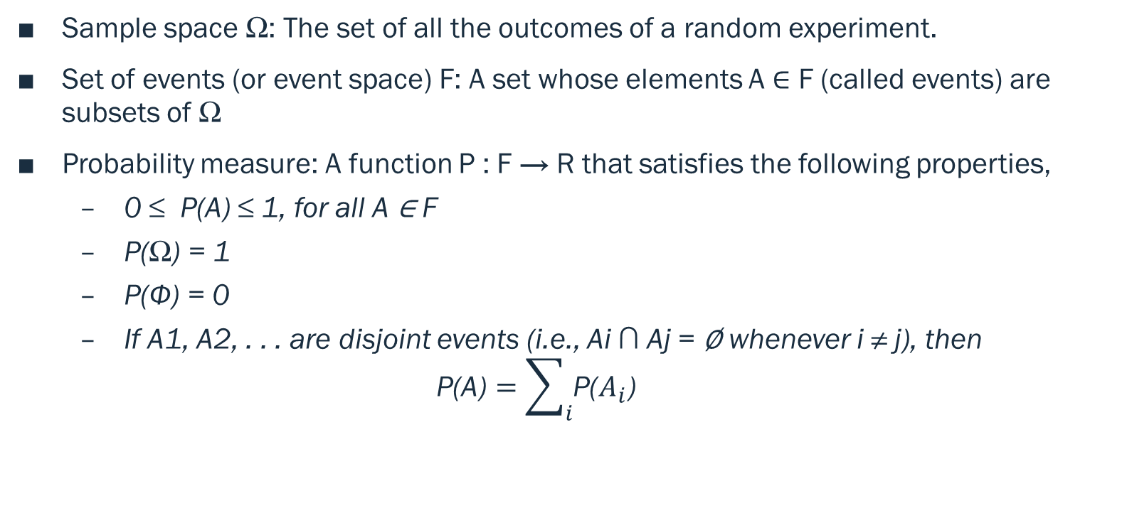
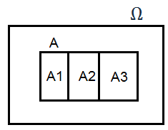
Elements of probability

Slide 7
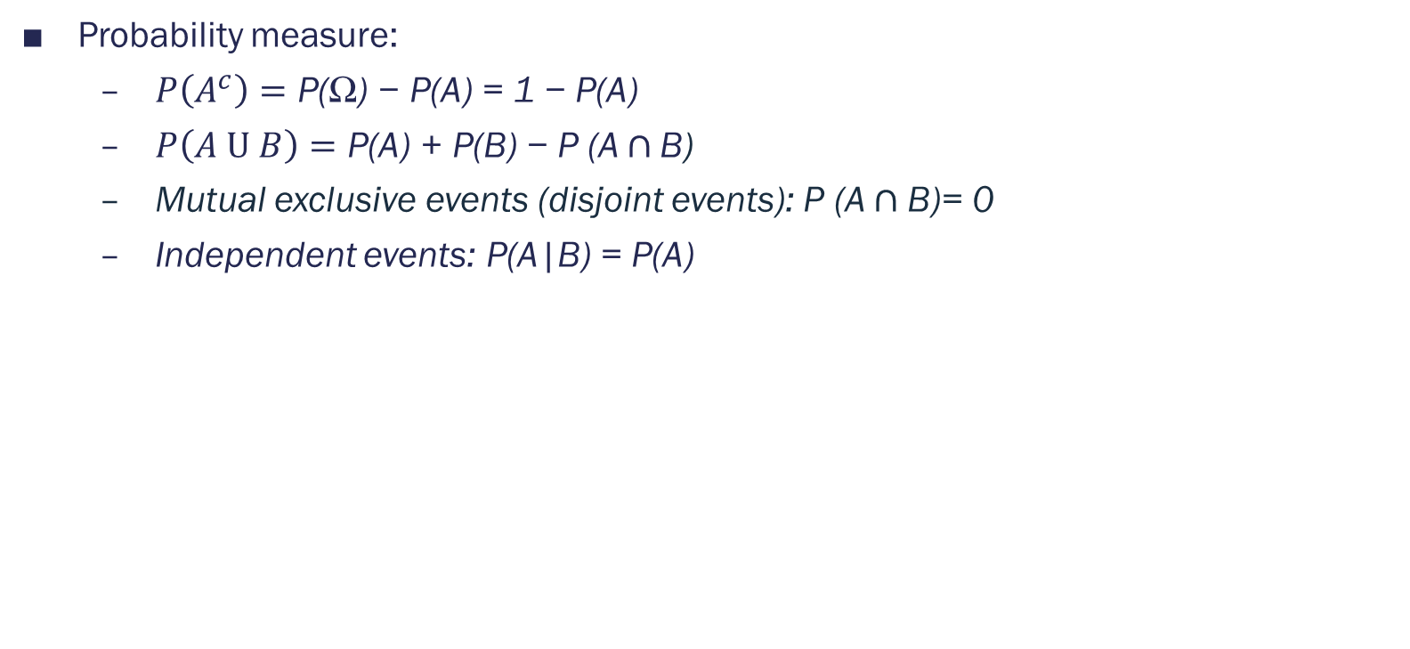
Elements of probability

Slide 8
Elements of probability
Conditional Probability: Probability of event A given event B occurred.
P(A given B) = P(A | B)
Joint Probability: Probability of events A and B.
P(A , B) = P(A ⋂ B)= P(A | B) * P(B) = P(B | A) * P(A)
Marginal Probability: Probability of event X=A given variable Y.
P(X=A) = sum P(X=A, Y=yi) for all y

Slide 9
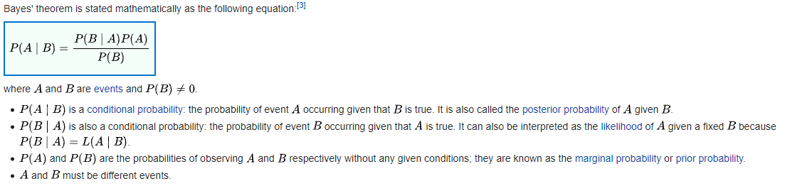

Bayes Rule

Slide 10
Random variables and probability distributions
A random variable is a numerical description of the outcome of a statistical experiment.
A random variable that may assume only a finite number of values is said to be discrete.
One that may assume any value in some interval on the real number line is said to be continuous.

Slide 11
Random variables and probability distributions
The probability distribution for a random variable describes how the probabilities are distributed over the values of the random variable.
For a discrete random variable, x, the probability distribution is defined by a probability mass function, denoted by f(x).
This function provides the probability for each value of the random variable.
Two conditions must be satisfied: (1) f(x) must be nonnegative for each value of the random variable, and (2) the sum of the probabilities for each value of the random variable must equal one.

Slide 12
Random variables and probability distributions
For a continuous random variable, x, it is not meaningful to talk about the probability that the random variable will take on a specific value; instead, the probability that a continuous random variable will lie within a given interval is considered. This is called the probability density function, also denoted by f(x).
The probability that the variable will take on a value within an interval is the area under the graph of f(x) corresponding to that interval, obtained by computing the integral of f(x) over that interval. A probability density function must satisfy two requirements: (1) f(x) must be nonnegative for each value of the random variable, and (2) the integral over all values of the random variable must equal one.

Slide 13
Expectation
The expected value, or mean, of a random variable—denoted by E(x) or μ—is a weighted average of the values the random variable may assume.
In the discrete case the weights are given by the probability mass function, and in the continuous case the weights are given by the probability density function.
E(x) = Σxf(x) (For discrete random variables)
E(x) = ∫xf(x)dx (For continuous random variables)

Slide 14
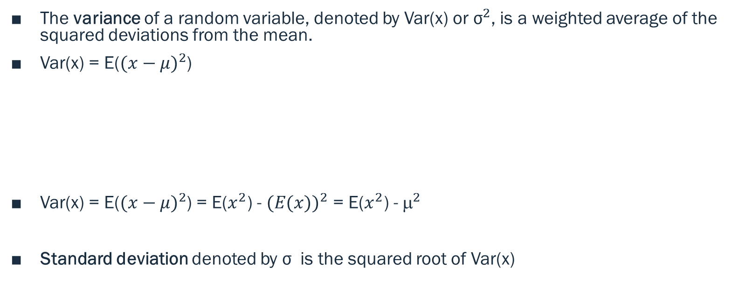

Variance

Slide 15
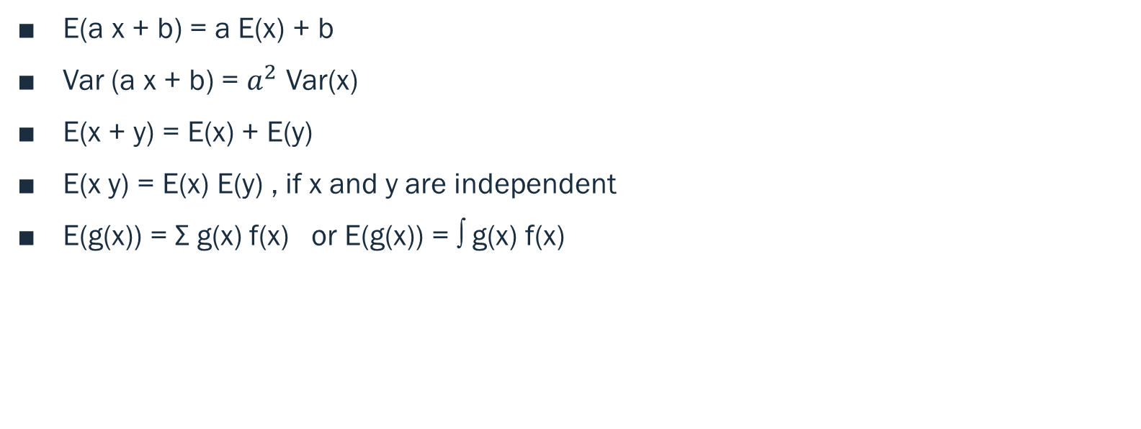
Properties

Slide 16
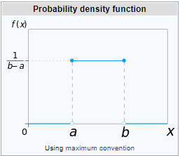

Special probability distributions
Continuous uniform distribution

Slide 17
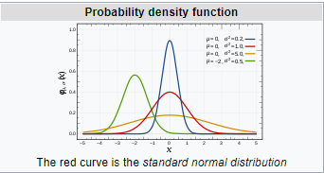

Special probability distributions
Normal (Gaussian) distribution

Slide 18
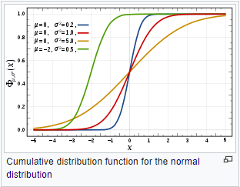



Cumulative Distribution Function - CDF
Cumulative Distribution Function (CDF) of a random variable X is the probability that X will take a value less than or equal to x
For Discrete Random Variable X
For Continuous Random Variable X

Slide 19
Matrix Operations

Slide 20
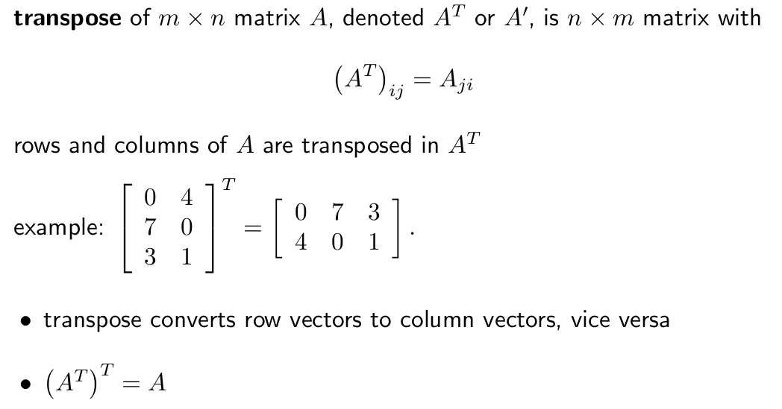
Matrix Transpose

Slide 21
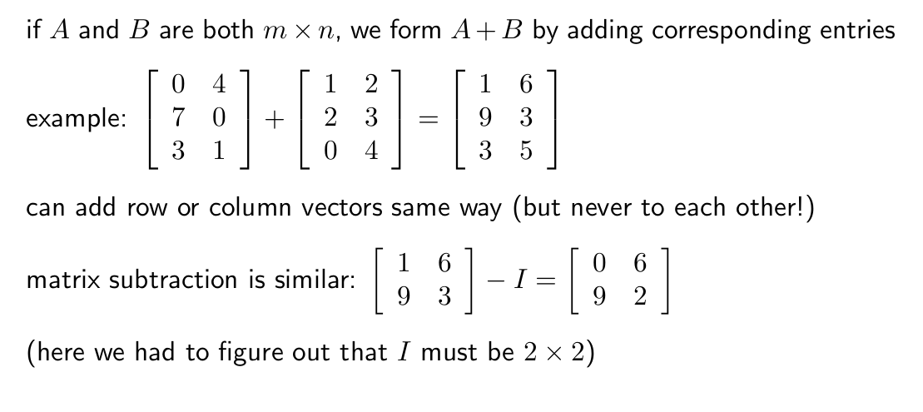
Matrix Addition and Subtraction

Slide 22
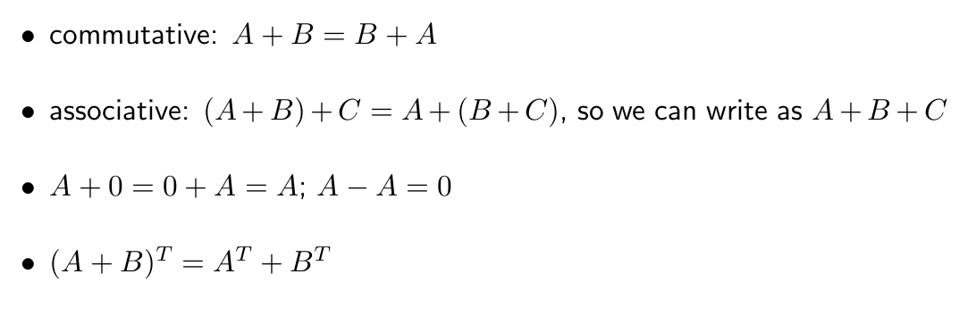
Properties of Matrix Operations

Slide 23
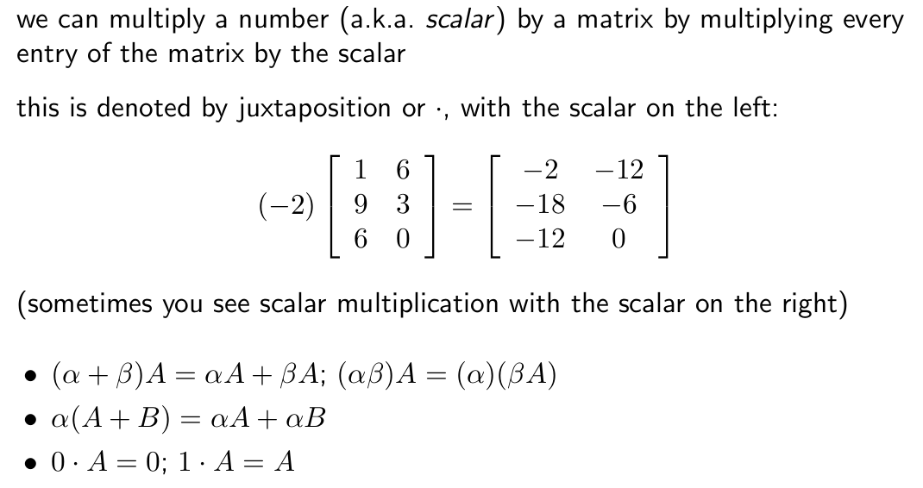
Scalar Multiplication

Slide 24
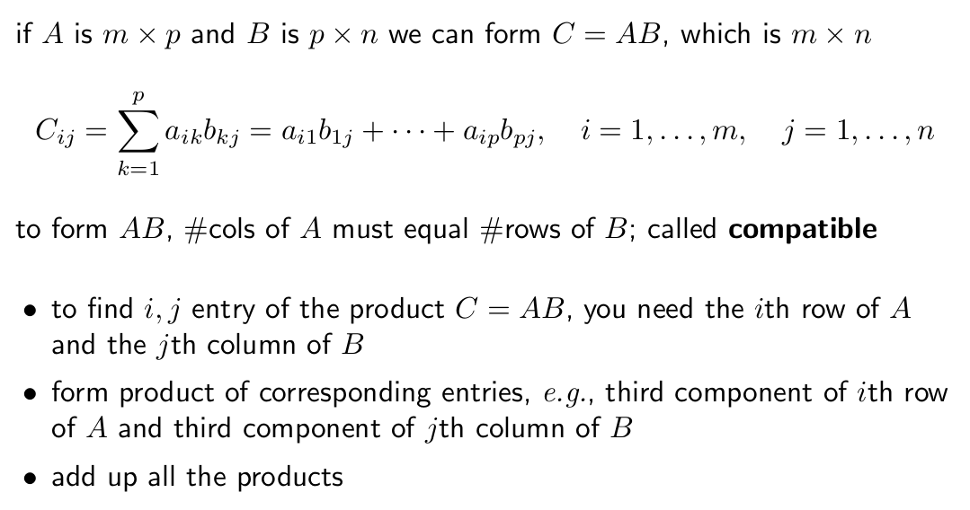
Matrix Multiplication

Slide 25
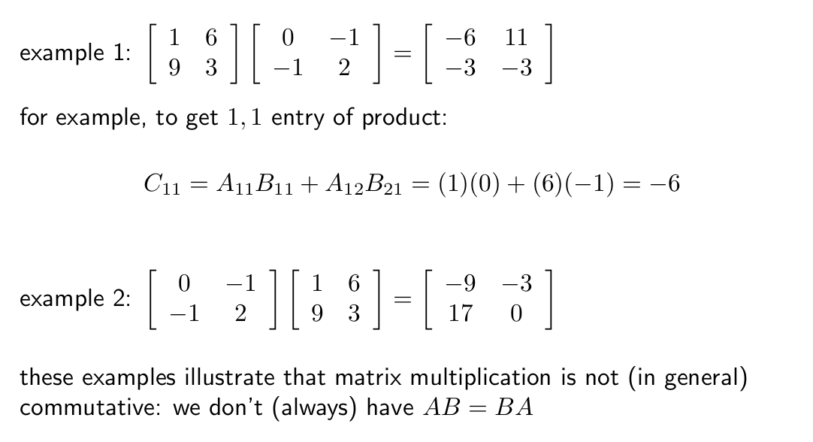
Matrix Multiplication

Slide 26
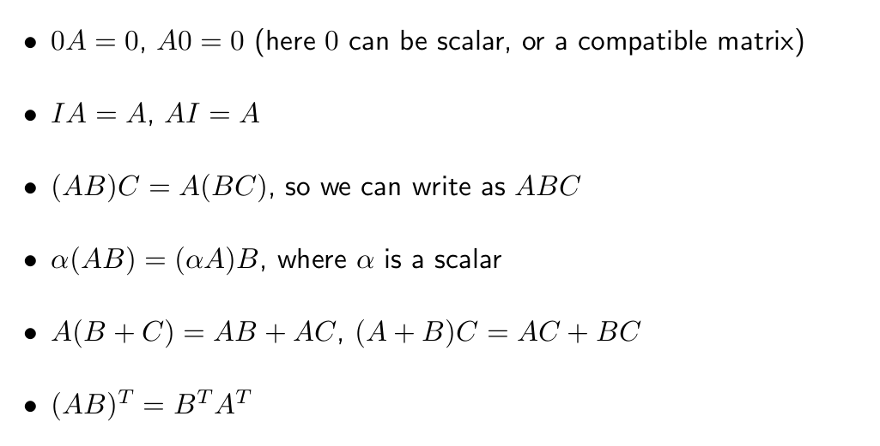
Properties of Matrix Multiplication

Slide 27
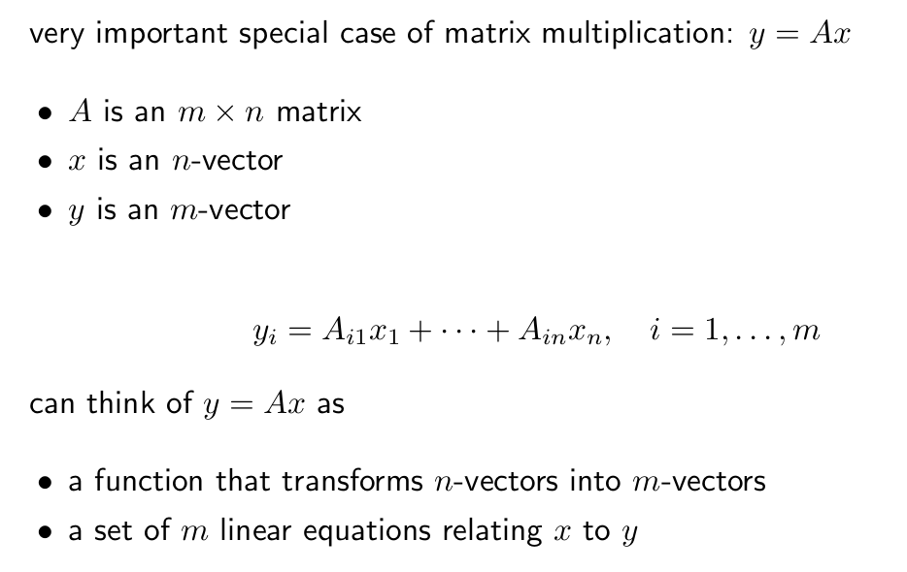
Matrix-Vector Product

Slide 28
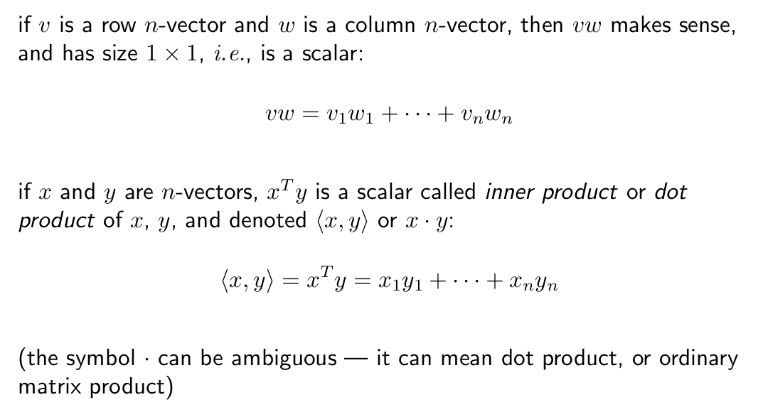
Inner Product

Slide 29
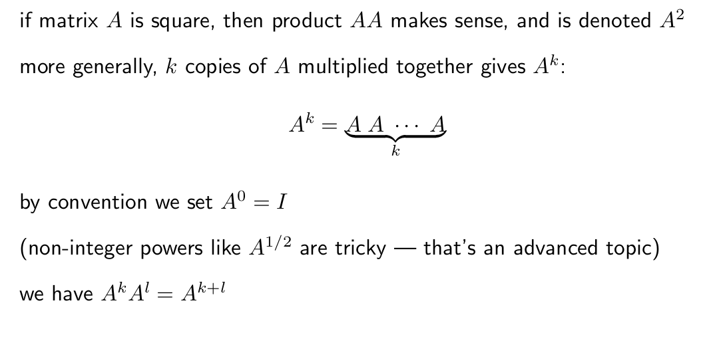
Matrix Powers

Slide 30
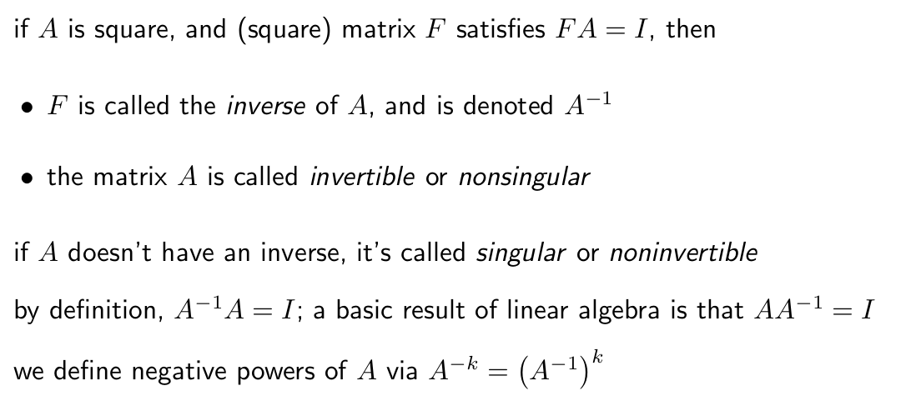
Matrix Inverse

Slide 31
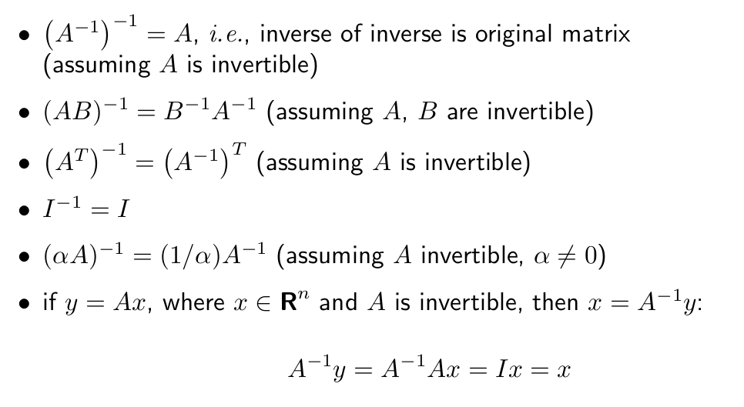
Properties of Inverse

Slide 32
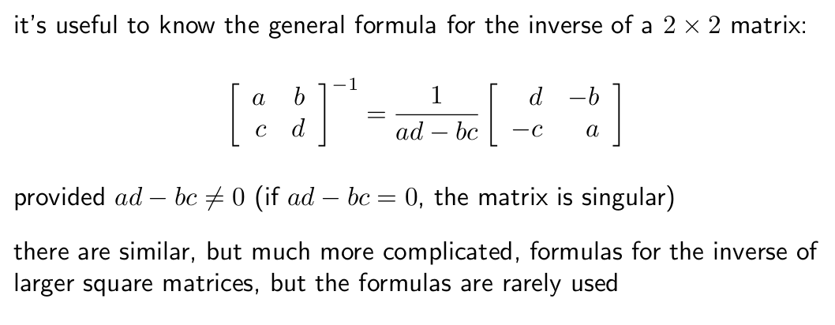
Inverse of 2x2 Matrix

Slide 33
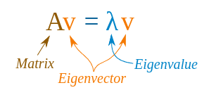
Eigen Decomposition
Why? Get directions that characterize a feature space.
Try to solve:

Slide 34
Eigen Decomposition
Steps:
Av = λv
Av - λv = 0
(A - λI)v = 0
|A - λI| = 0

Slide 35
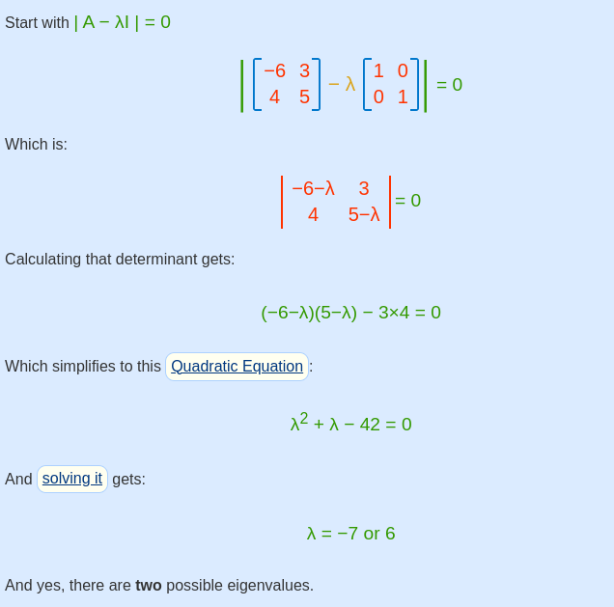
Eigen Decomposition

Slide 36
Eigen Decomposition

